Slide 1
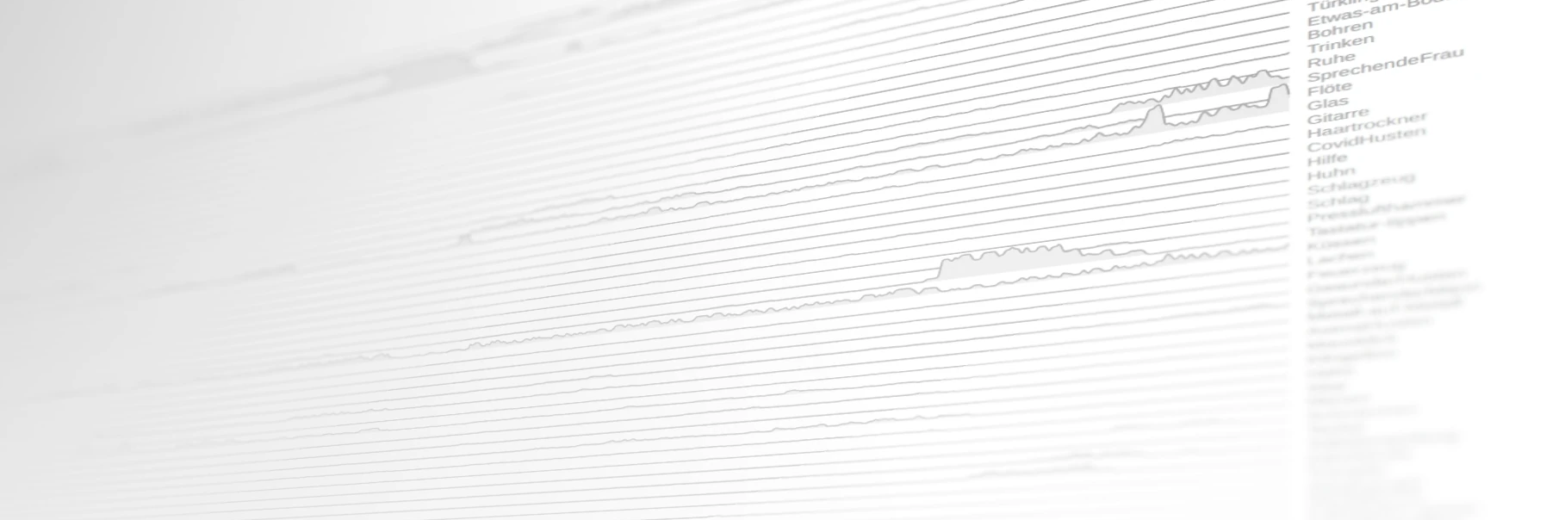
Department of Computer Science Junior Professorship of Media Computing
System Design, Implementation and Evaluation of a User-centered Application for Indoor Sound Classification

Slide 2
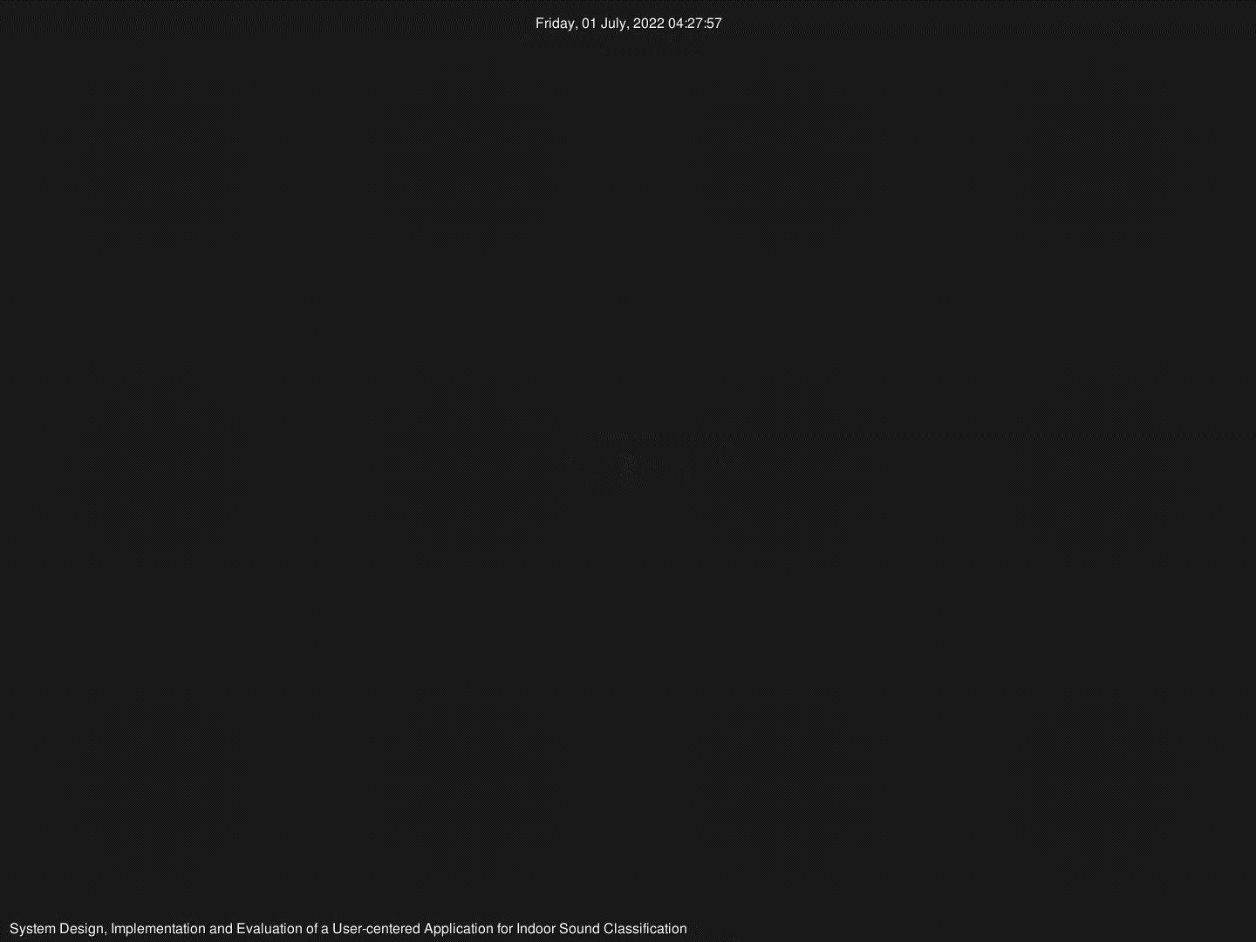
Overview

Slide 3
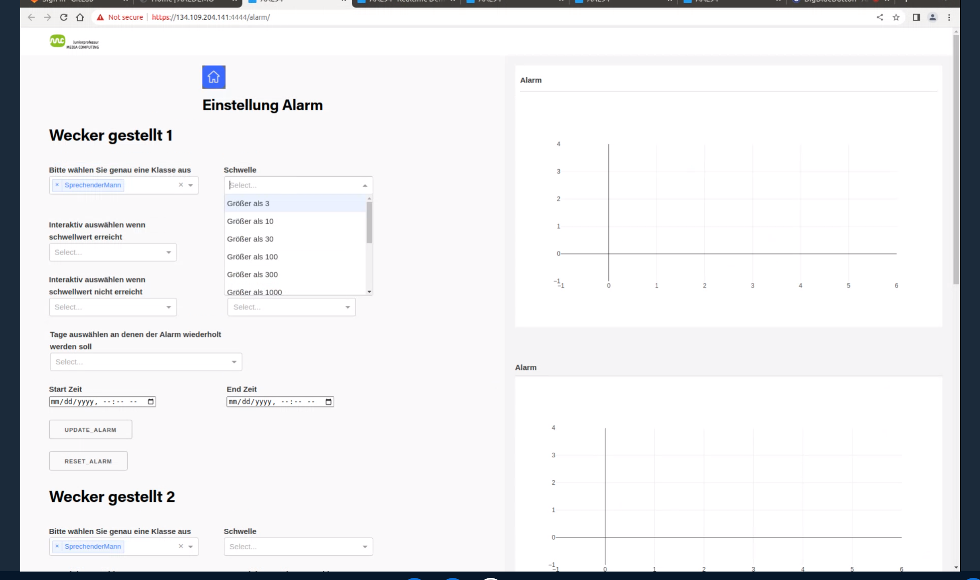
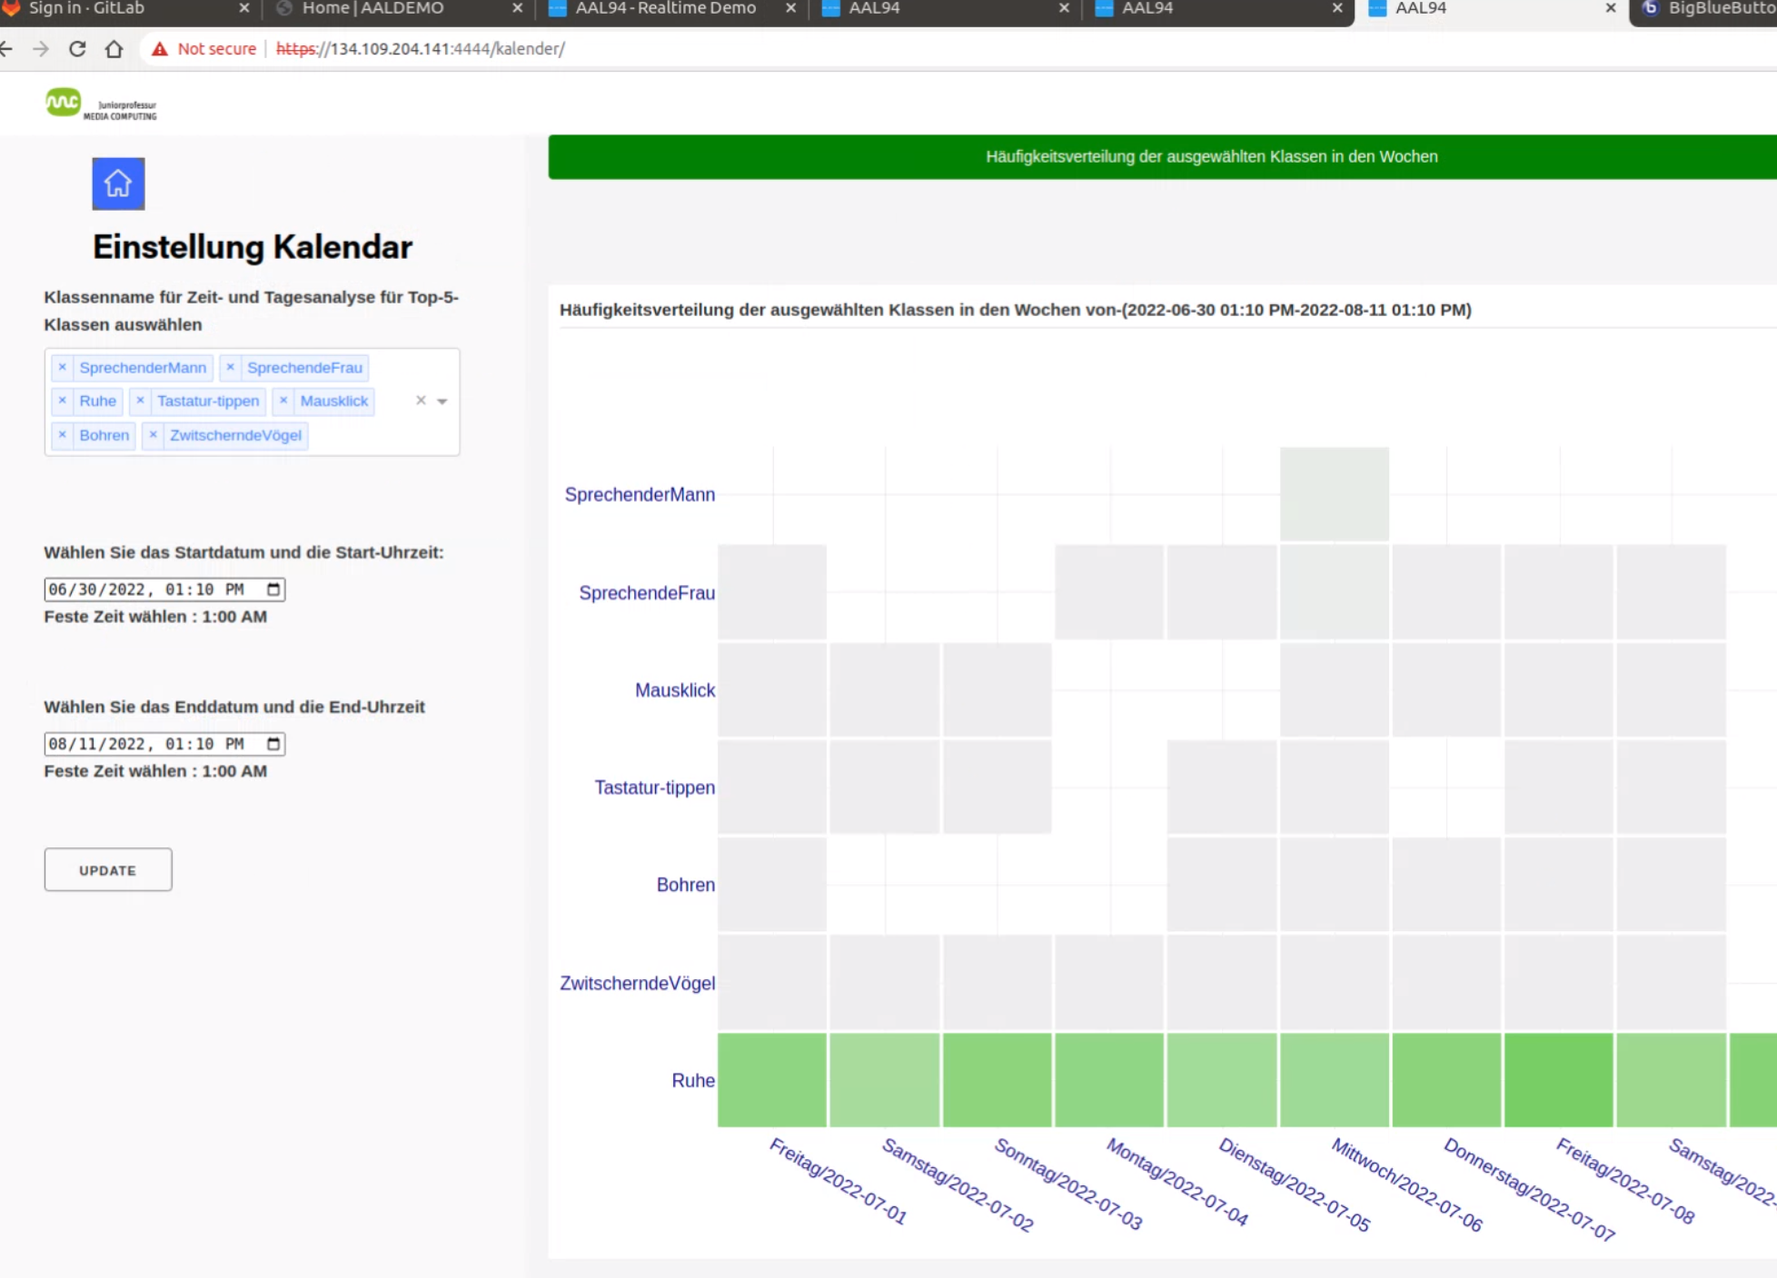
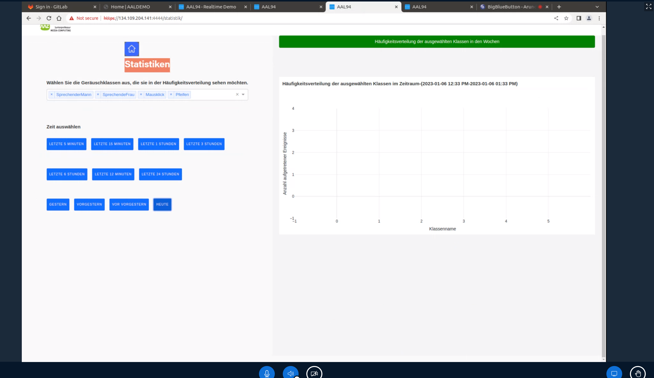
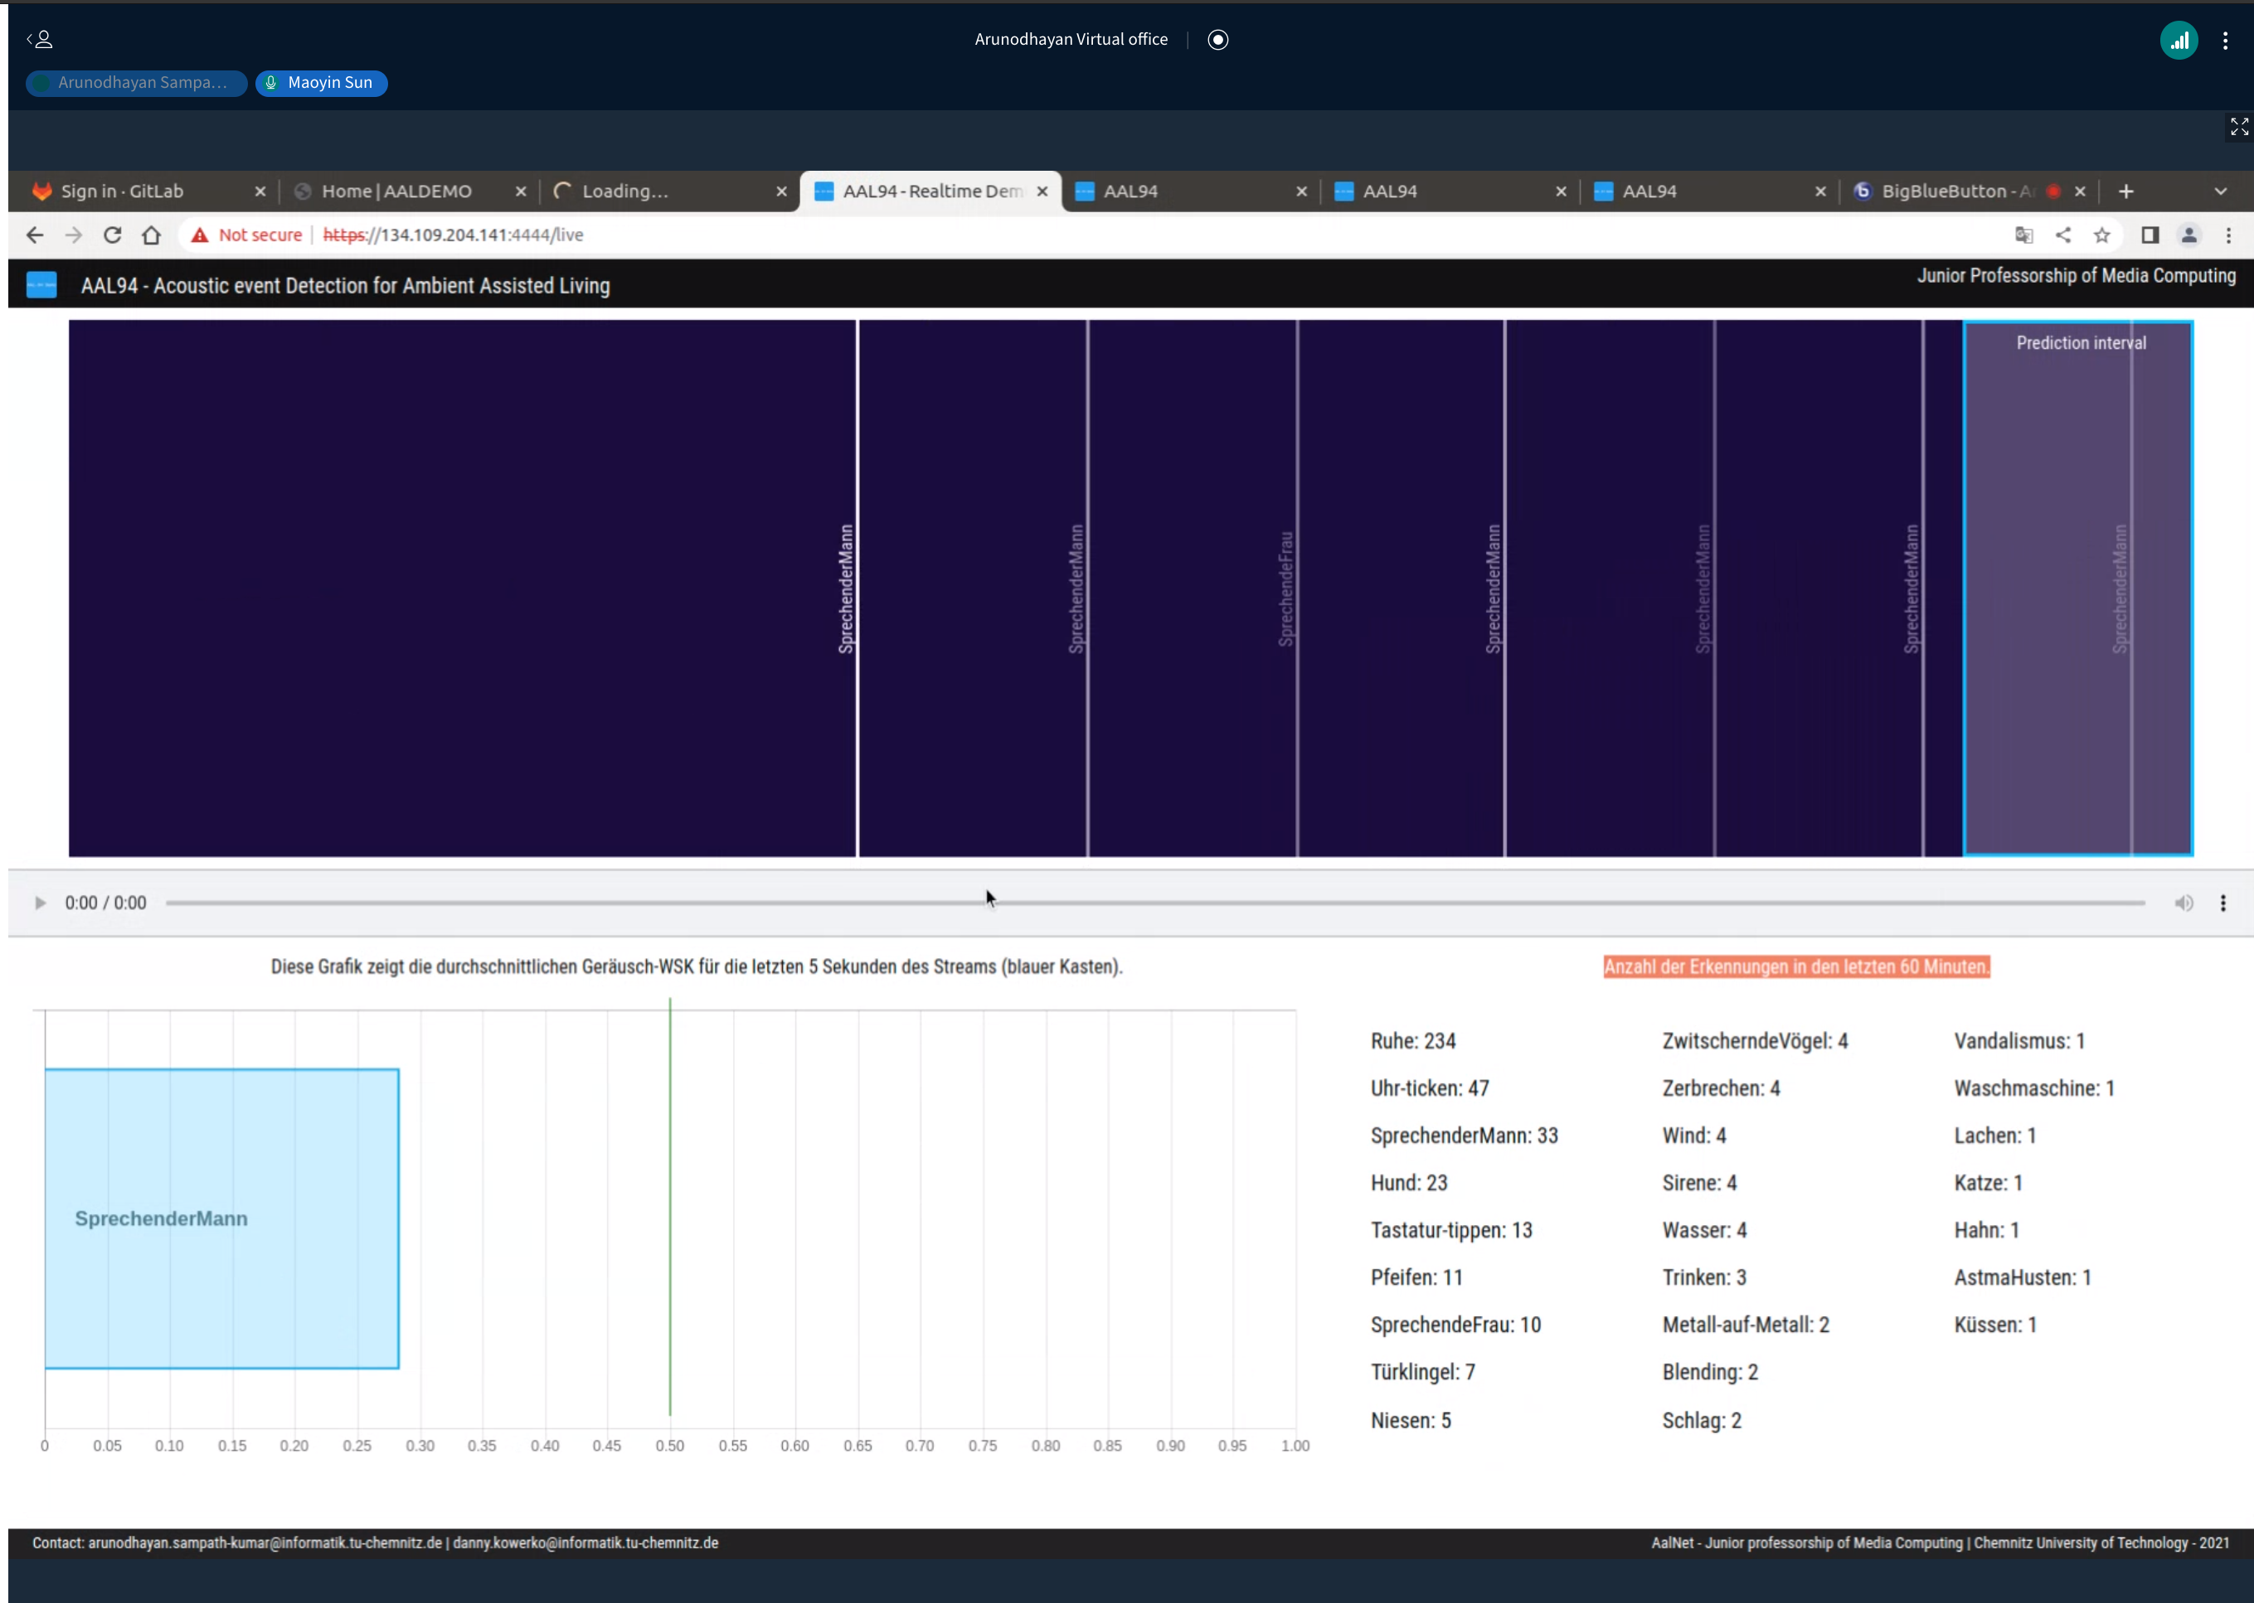
Background
Lack of user-friendly and robust applications
Inability to scale up
Efficiency

Slide 4
Background
Feedback from non-users of IAA App
Higher speed
More robustness
More informative visualization
Clearer interface
Better usability

Slide 5
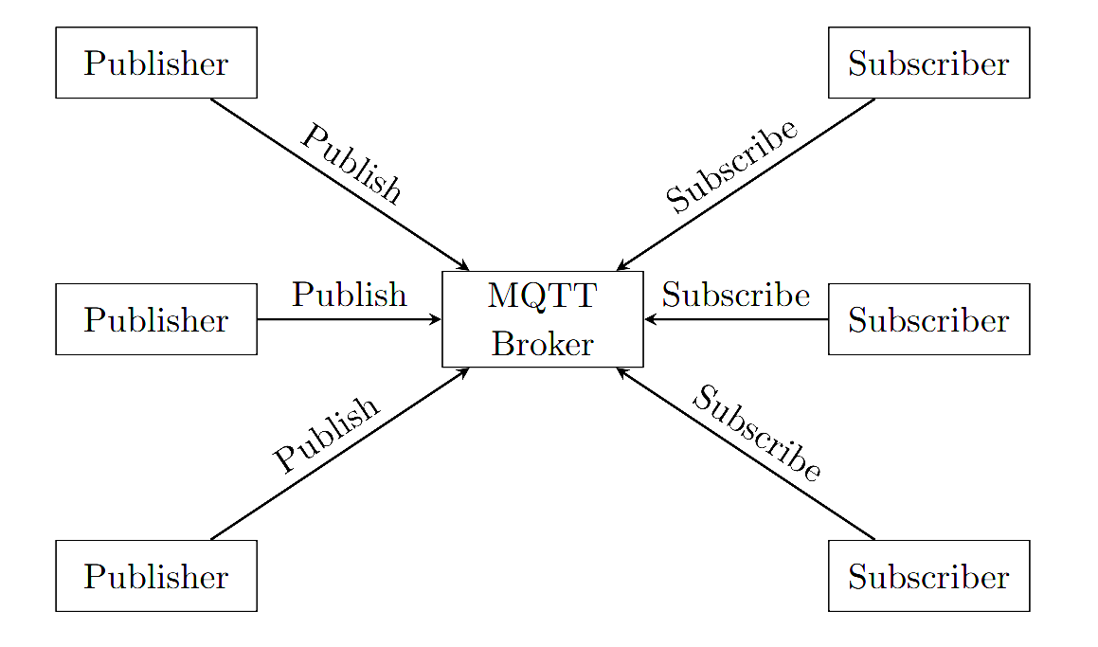
Proposed Demonstration Platform
Pub-sub messaging pattern
Asynchronous Messaging
Decoupled Architecture

Slide 6








Backend
Docker
Nginx
Traefik
Mosquitto
Grafana
Prometheus
Express
…

Slide 7



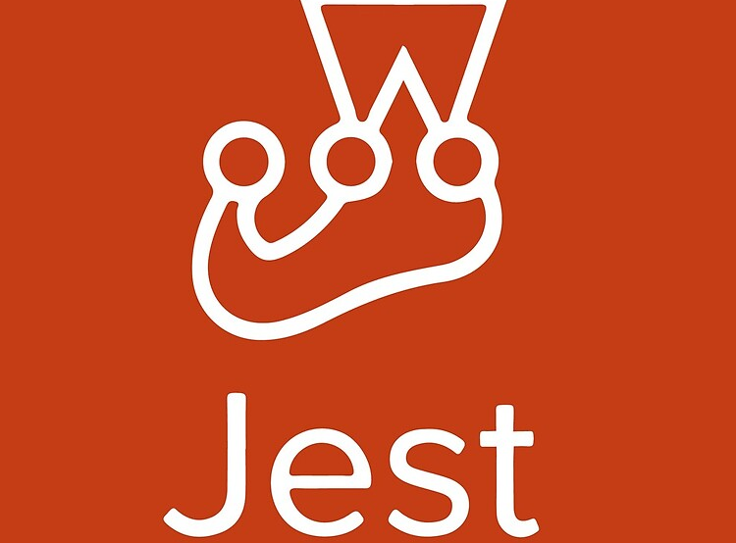









Frontend
Bootstrap
D3
React
Babel
Webpack
Yarn
Jest
…

Slide 8
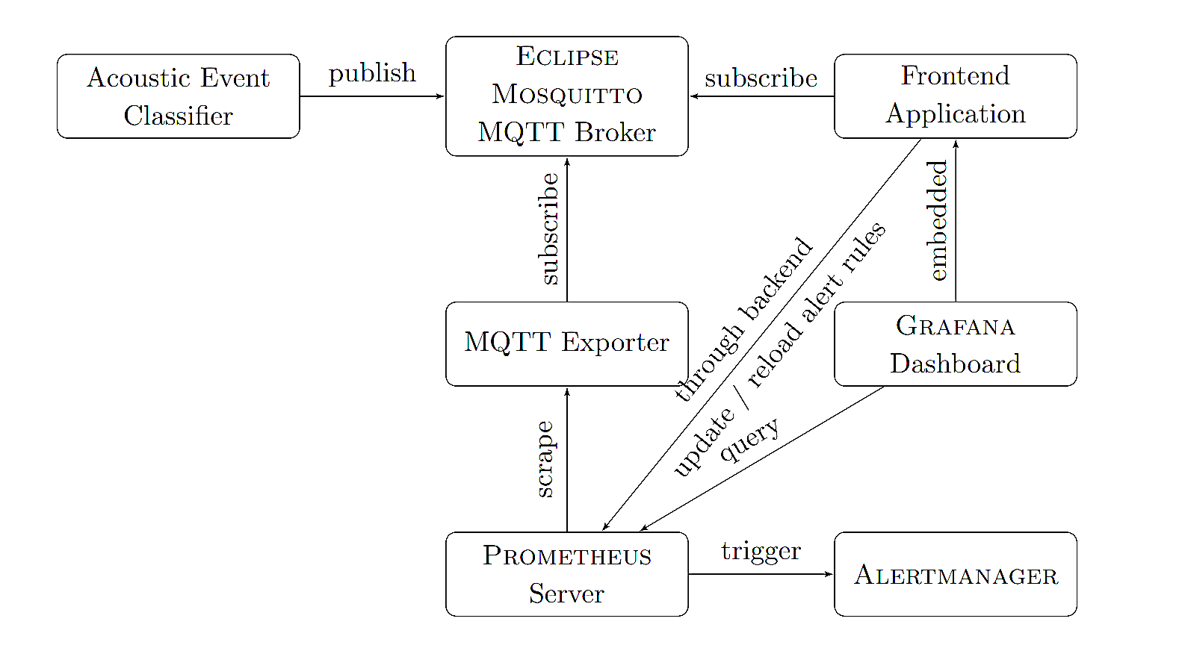
Implementation and Deployment
Notes:
This is how I deploy the backend.

Slide 9
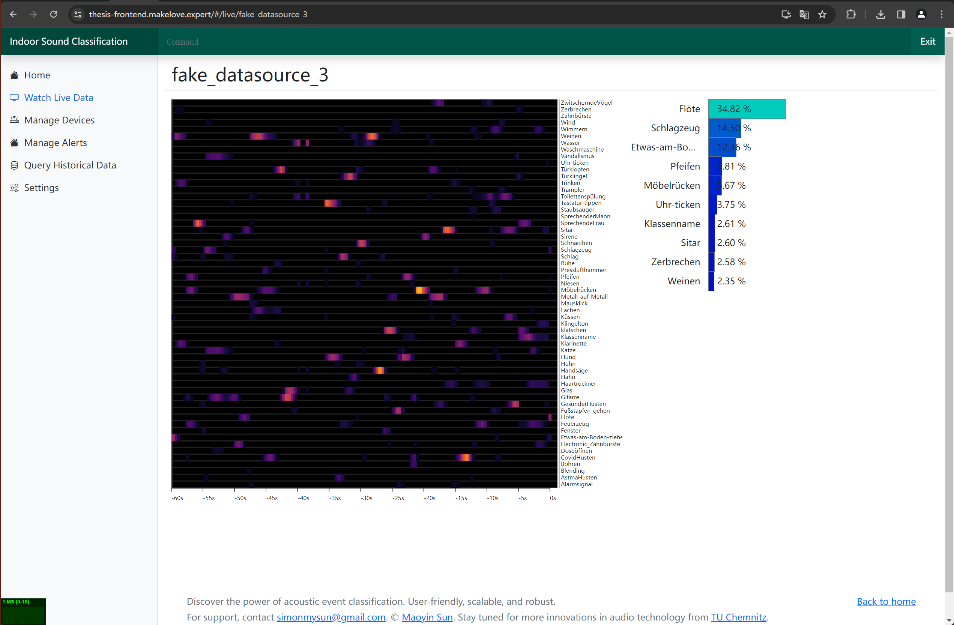
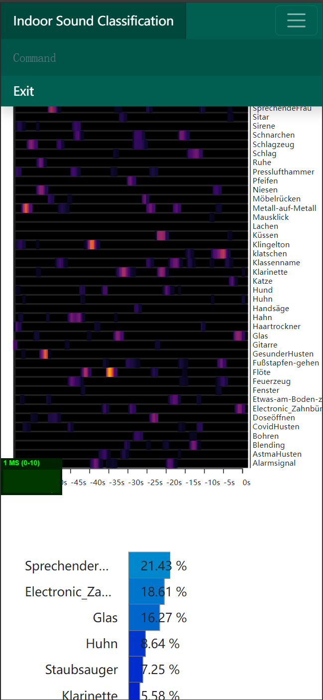
Implementation and Deployment

Slide 10
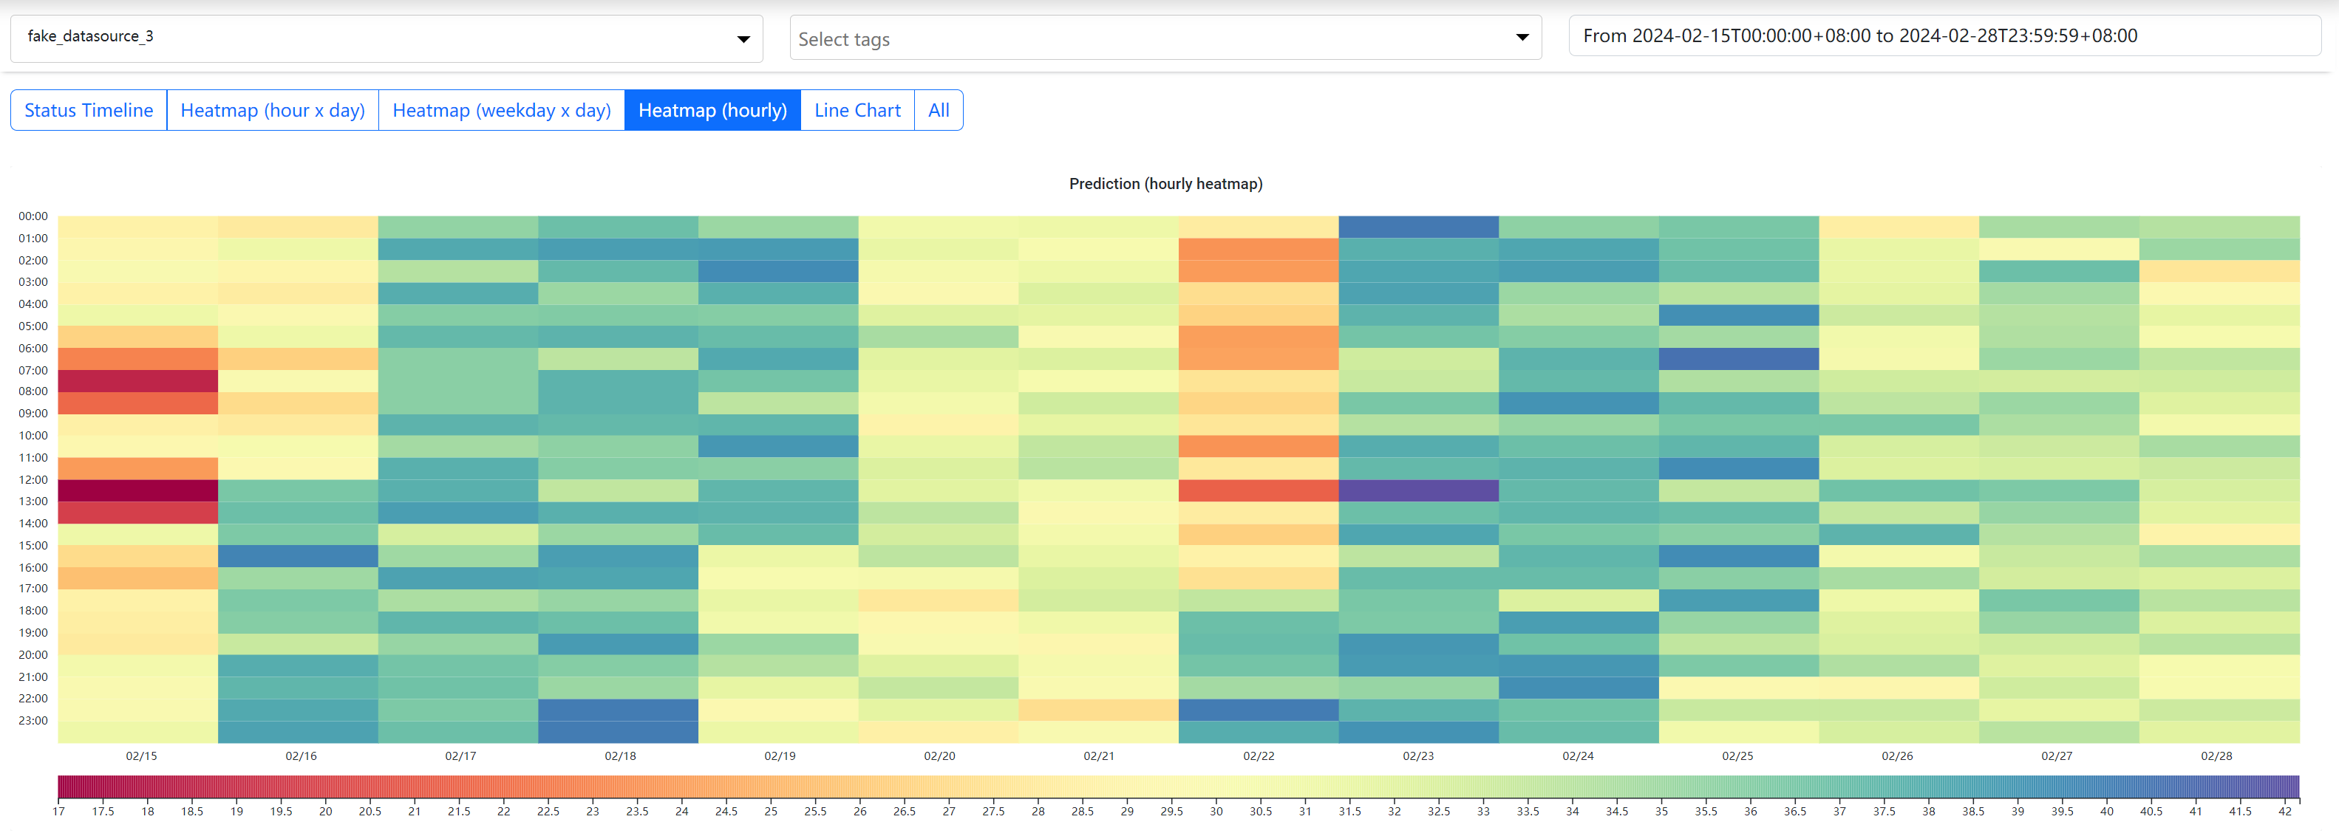
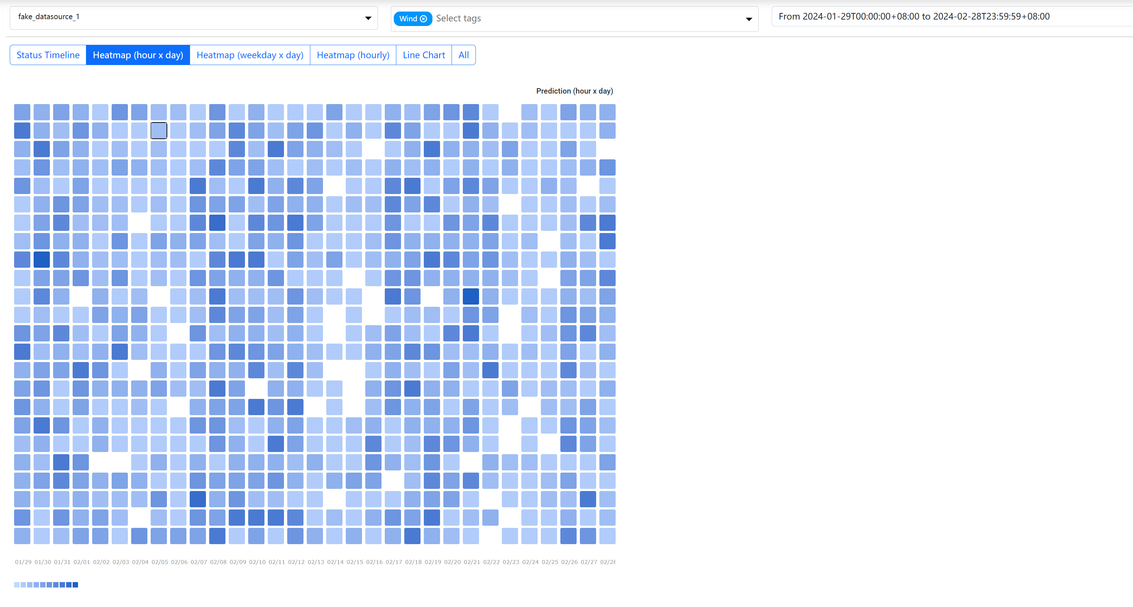
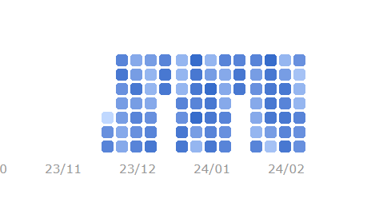
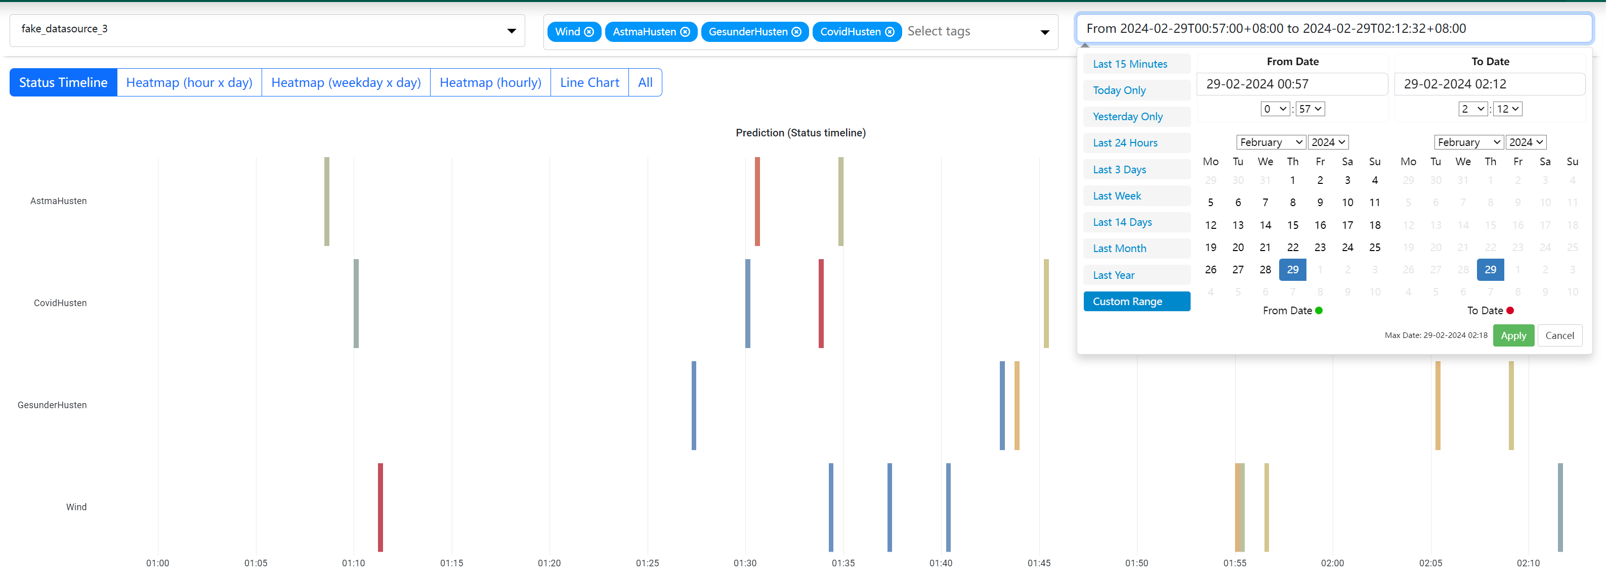
Implementation and Deployment

Slide 11
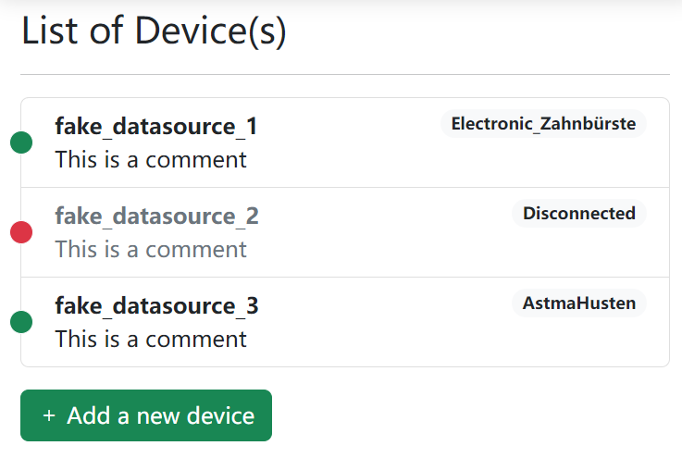
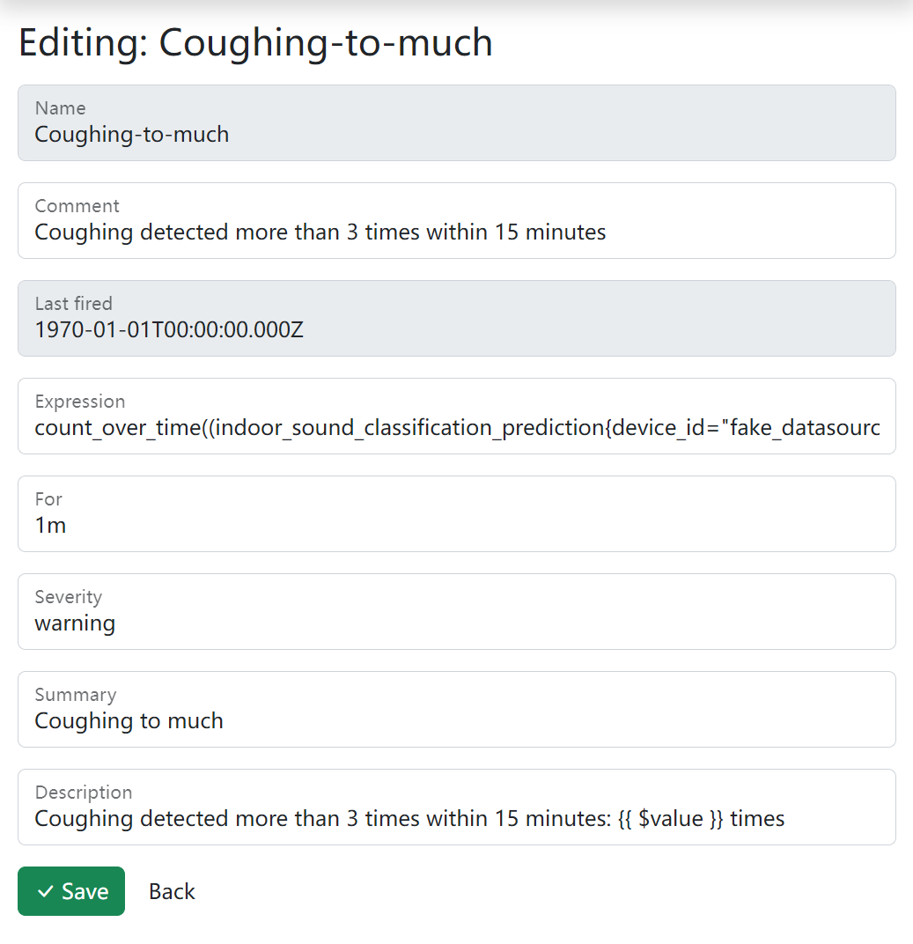
Implementation and Deployment

Slide 12
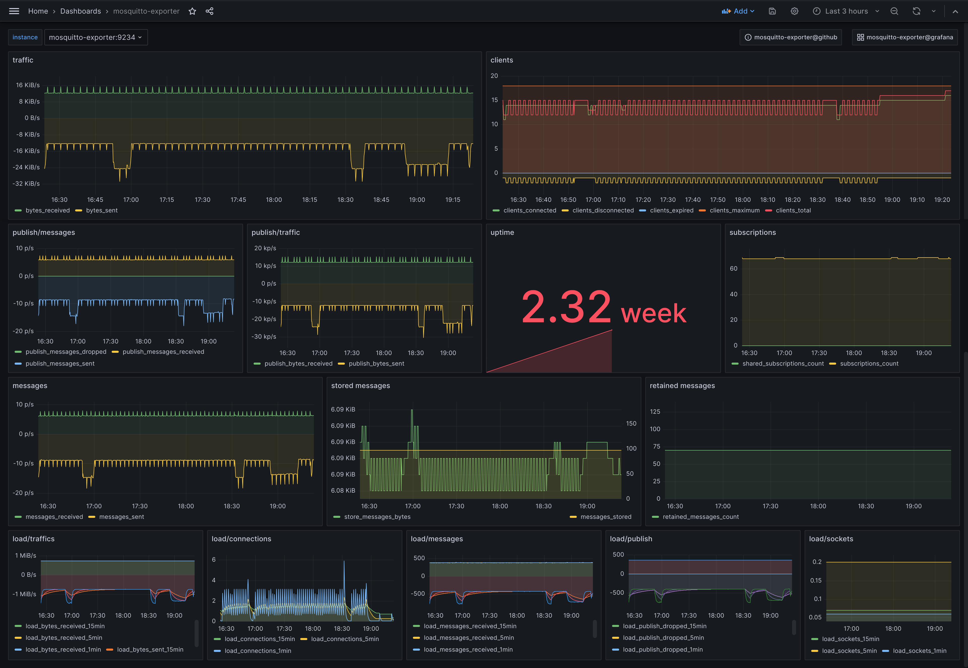
Implementation and Deployment
Realtime performance tracking

Slide 13
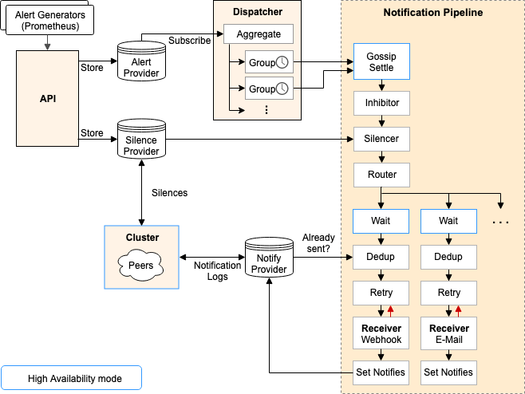
Implementation and Deployment

Slide 14
Evaluation
Performance tests
Unit tests
Integration tests
Web Vitals
WCAG
Efficiency
Scalability
Robustness

Slide 15
Future work and research directions
Appliable to other classification model
Alert rules editor not good enough
ACL not implemented yet

Slide 16
References
Al Galvis: Messaging Design Pattern and Pattern Implementation, in 17th conference on Pattern Languages of Programs-PLoP, Citeseer, 2010.
Stefan Kahl, Hussein Hussein, Etienne Fabian, Jan Schloßhauer, Enniyan Thangaraju, Danny Kowerko and Maximilian Eibl: Acoustic Event Classification Using Convolutional Neural Networks, in INFORMATIK 2017 (edited by Maximilian Eibl and Martin Gaedke), pp. 2177–2188, Gesellschaft fur Informatik, Bonn, Chemnitz, Germany, 2017. ¨ URL https://doi.org/10.18420/in2017_217
A Sampathkumar, R Erler and D Kowerko: CNN-based Audio Classification for Environmental Sounds, Ambient Assisted Living and Public Transport Environments using an Extensive Combined Dataset, Chemnitzer Informatik Berichte, vol. CSR-20-01:pp. 29–66, Jan. 2019. URL https://www.tu-chemnitz.de/informatik/service/ib/pdf/CSR20-01.pdf
Arunodhayan Sampathkumar, Ren´e Erler and Danny Kowerko: A RealTime Demo for Acoustic Event Classification in Ambient Assisted Living Contexts, in Proceedings of the 27th ACM International Conference on Multimedia, pp. 2205–2207, ACM, Oct. 2019. URL https://doi.org/10.1145/3343031.3350600
Arunodhayan Sampathkumar and Danny Kowerko: Low Complexity Acoustic Scene Classification Using Aalnet-94 , Tech. rep., DCASE2020 Challenge, Jun. 2020. URL https://dcase.community/documents/challenge2020/ technical_reports/DCASE2020_Sampathkumar_42.pdf
Bewertung der Anwendung IAA durch Nicht-Nutzer (Antworten)
prometheus/alertmanager: Prometheus Alertmanager , https://web.archive.org/web/20220629085738/https://github.com/prometheus/alertmanager, accessed: 2022-06-29.
W3C Web Accessibility Initiative (WAI): Accessibility, Usability, and Inclusion — w3.org, https://www.w3.org/WAI/fundamentals/ accessibility-usability-inclusion/, [Accessed 19-11-2023].

Slide 17
Q&A

